Slide 1
Healthy G
Asaad, Fatima Naiza Caparas, Alethea Mari Catabijan, Mark ANGELO D. LACANLALE, EDWARD FRANCIS

Slide 2
Statement of the Problem and Solution
Annually, there is a high mortality rate for preventable diseases. This is due to bad diet and lifestyle or genetics that is triggered by unhealthy diet and lifestyle.
All children follow the diet that is followed by their parents because they eat what is served at their table
There is an endless cycle of children adopting bad diet which in turn is picked up by their children when they become adults.
To prevent such problem, these children must be taught a healthier diet early on. The earlier people start a good diet, the less repercussion the bad diet will have on them, and the more benefits the good diet will have on them (ex. Height)

Slide 3
Description
Healthy G is a mobile app that teaches a healthy diet aimed at children through a simple game
The player is presented food and he/she chooses under what category the food is based on: go, glow, grow, or junk
The player is given three lives. His/her life is reduced when he/she chooses the wrong answer.

Slide 4

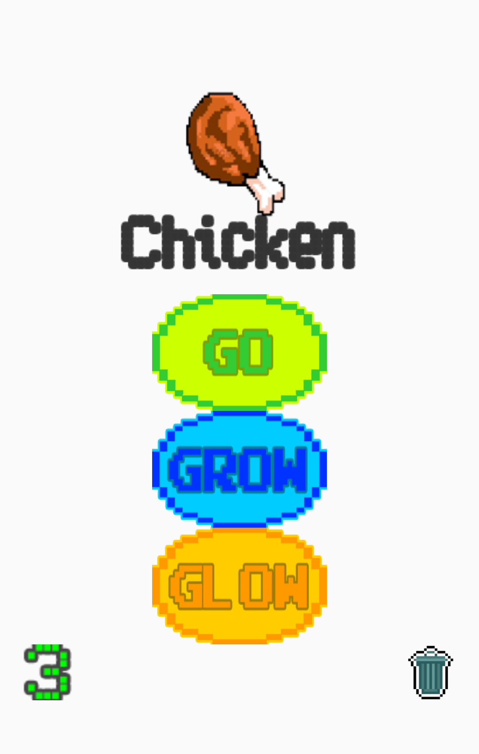
Demo

